Slide 1

WELLCOME

Slide 2

Introduce
Suchitra Chakma
Assistant teacher
Tintila govt.primary schol
Longadu upzilla
Rangamati

Slide 3


Lesson Introduce
SUB-ENGLISH FOR TODAY
CLASS:-2
TIME-50 minutes
Lesson Unit-6 (Shapes and sizes)
Lesson :- 1 & 2
Page no :- ( 34-36)

Slide 4
Learning Outcomes-
Student will be able
To draw circle, square , triangle , and rectangle
To recognize & say circle, square , triangle , and rectangle
To learn words meaning & spelling (circle, square , triangle , and rectangle etc

Slide 5

Emotion Create:
With shapes video

Slide 6
Do you say what are the pictures name?
A Square
A circle
বর্গ
বৃত্ত
A Rectangle
ত্রিবুজ
আয়তাকার
A triangle

Slide 7
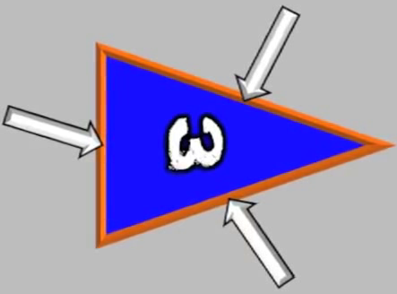
INPUT-10 minutes
What is this?
What is this?
This is a circle
This is a triangle
বৃত্ত
ত্রিবুজ

Slide 8
I will discuss about the picture
A Rectangle
4
sites are the same
2 short
2 long
A Square

Slide 9
What’s this ? Look, point and say.
A square or a triangle ?
1
2
Circle or a square ?
Circle or a square ?
3
a square or a rectangle
a triangle or a square ?
4

Slide 10
Practice
wcw
Lets draw Shapes
Practice-wcw
A Triangle
A Square
ত্রিবুজ
বর্গ
A circle
A Rectangle
বৃত্ত
আয়তাকার

Slide 11
Which one is a square ?
Which one is a triangle ?

Slide 12
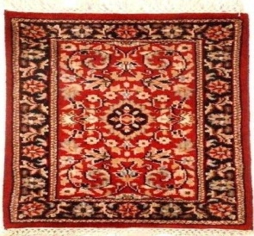
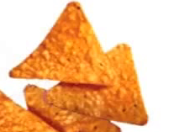


Mach.ONE IS DONE FOR YOU

Slide 13
Open your book (Page no.35)
Read this following words with spelling
Square, Rectangle, Square, Circle
And practice in pairs

Slide 14
LEARNING ASSESSMENT
Time-10 minutes
What is this ?
What is this ?
What is this ?
What is this ?

Slide 15
HOME WORK
These shapes are home work tomorrow (Square, Triangle, Rectangle & Circle)

Slide 16
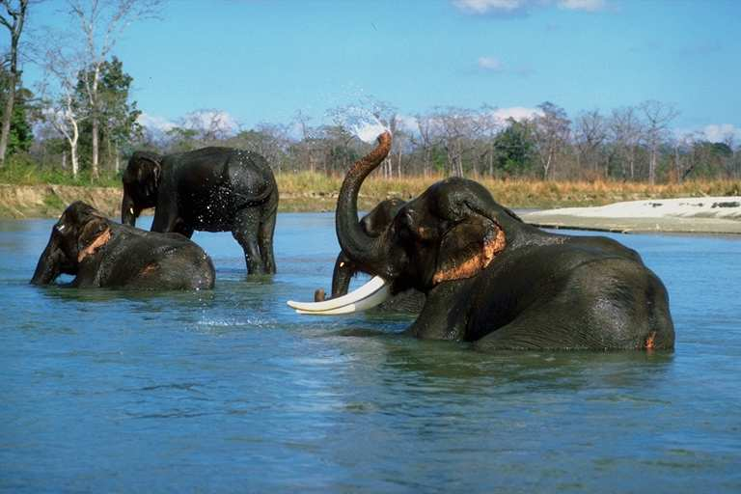
THANKS

